Slide 1
X-Ray Tubes

Slide 2
Objectives
The student will be able to:
1. Define thermionic emission.
2. Describe the line focus principle and the heel effect.
3. Define anode heat units.
4. Recognize allowed and forbidden tube heat loads

Slide 3
Key Terms
● actual focal spot ● anode ● anode angle
● cathode ● effective focal spot ● filament
● focal spot ● focal spot blooming ● focal track
● focusing cup ● heel effect ● leakage radiation
● line focus principle ● off-focus radiation ● rotating anode
● rotor ● SID ● space charge effect
● thermionic emission

Slide 4
Introduction
This chapter covers the components, operation, and limitations of x-ray tubes.
The purpose of the x-ray tube is to produce an x-ray beam.
The x-ray tube contains a negative electrode that when the current is applied to it, will produce a mass of electrons that will interact with a positive electrode in order to produce x-rays.

Slide 5
Introduction
The negative electrode is on one side of the x-ray tube.
It is called the cathode.
The cathode contains a filament.
The positive electrode is on the opposite side of the x-ray tube. It is called the anode.
The anode contains a focal spot where the electrons interact to produce the x-rays

Slide 6
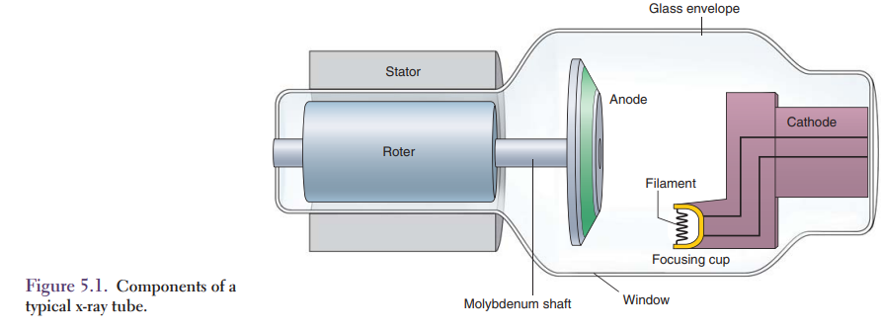
X-Ray Tube
The cathode contains the filament, which is heated to boil off the projectile electrons.
The cathode is shaped like a cup to focus the projectile electrons onto the positive anode.
The anode contains a focal spot, which has an area of only a few square millimeters.

Slide 7
X-Ray Tube
In order to spread the heat from the projectile electrons over a larger area of the anode, the anode rotates.
The tube components are sealed inside an evacuated glass or metal envelope.
The vacuum allows the electrons to travel freely from the negative cathode to the positive anode.

Slide 8
Tube Housing
During the production of x-rays, they are emitted in all directions within the tube.
The x-rays that are emitted through the thin window of the tube housing make up the primary beam.
The thin window allows for the maximum amount of x-rays to be transmitted with very little absorption in the beam direction.
The remaining x-rays are absorbed by oil, which provides electrical insulation and cooling for the tube.

Slide 9
Tube Housing
The x-ray tube and oil are contained in a metal housing.
The housing protects against electric shock and absorbs leakage radiation emitted outside the x-ray beam.
The leakage radiation is a source of unnecessary exposure for the radiographer and patient.
Regulations require that the leakage radiation through the tube housing be less than 100 mR/h at one meter from the tube.
A fan is often used to transfer the heat from the housing to the room air by convection (Fig. 5.1).

Slide 11
Glass Envelope
The x-ray tube is a vacuum tube with two electrodes: the cathode and the anode.
These components are housed in an evacuated glass envelope made of Pyrex glass to withstand the tremendous heat generated by the production of x-rays.
All air is removed from the glass envelope creating a vacuum which allows electrons to flow from the cathode to the anode.
The vacuum allows an efficient production of x-rays and also extends the life of the tube.

Slide 12
Glass Envelope
Modern x-ray tubes are commonly designed with a metal envelope.
They prolong the tube life and eliminate tungsten vaporization which coats the inside of the envelope.
This coating can result in electrons arcing which causes tube failure.
The metal envelope avoids this from happening because there is a constant electrical potential between the electrons in the tube current and the envelope.

Slide 13
Cathode
The cathode is the negative electrode of the x-ray tube.
The function of the cathode is to produce a thermionic cloud, conduct the high voltage to the space between the cathode and anode, and focus the electron stream as it speeds toward the anode.
It contains the filament or filaments, focusing cup, and wiring for filament current

Slide 14
Filament
The purpose of the filament is to provide projectile electrons for acceleration to the positive anode.
The filament, a coil of tungsten alloy wire, is heated to boil off electrons. Tungsten is the material of choice because it has a high melting point and resists vaporization; rhenium and molybdenum are also suitable materials.
Vaporization produces particles that deposit on surfaces inside the tube, which reduces the vacuum in the tube.

Slide 15
Filament
Changes in the fi lament current, termed milliamperes (mA), produce changes in the fi lament temperature.
This causes a change in the number of projectile electrons boiled off the fi lament in a process called thermionic emission.
Thermionic emission causes electrons to be boiled off the fi lament wire and to form a thermionic cloud.

Slide 16
Filament
Upon depression of the exposure switch, the electron cloud is driven toward the anode target where x-ray photons are produced.
An increase or decrease in the number of projectile electrons striking the anode changes the number of x-rays produced.
The size of the focal spot is determined by the size of the fi lament coil. Modern diagnostic x-ray tubes have two fi laments, one large and one small, called a dual focus system (Fig. 5.2).

Slide 17
Filament
The large filament is used when high x-ray production is needed.
The larger fi lament produces a larger focal spot to distribute the heat over a larger area which allows higher tube currents without damaging the anode.
The smaller filament produces a small focal spot when sharper images or better spatial resolution is required.

Slide 18
Filament
Lower tube currents should be used with small focal spots.
Large fi laments typically produce 0.4- to 1.2-mm focal spots, and small fi laments produce focal spots of 0.1 to 0.5 mm.
Focal spot size is selected automatically by selecting larger or smaller mA stations or manually by the focal spot size selection.

Slide 19
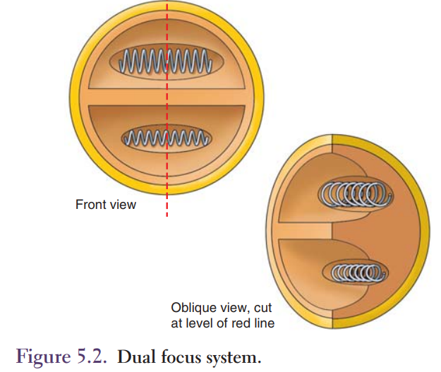

Slide 20
Filament Current
Upon turning on the x-ray machine, a low current fl ows through the fi lament to warm and prepare it for the high mA necessary to form a thermionic cloud.
The x-ray tube has fixed mA stations of 100, 200, 300, and so on to provide the necessary mA for a multitude of various exposures.
When the fi lament current is high enough for thermionic emission, a small increase in fi lament current results in a large increase in tube current.

Slide 21
Focusing Cup
The focusing cup is made of nickel and has two shallow depressions which contain the filaments.
Electrons with their negative charge tend to diverge in a wide pattern because of electrostatic repulsion.
The low negative charge on the focusing cup surface forces the projectile electrons together into a narrow beam as they are accelerated toward the anode.

Slide 22
Focusing Cup
The anode region where the projectile electrons strike is called the focal spot.
Figure 5.3 shows the focusing action of a typical dual focus cup.
When sufficient mA is applied, the electrons begin to build up into a cloud around the fi lament; this is called a space charge.
The electrons reach a point where their negative charges begin to oppose the emission of additional electrons in a phenomenon called space charge effect.
The space charge effect limits x-ray tubes to maximum mA ranges of 1,000 to 1,200.

Slide 23
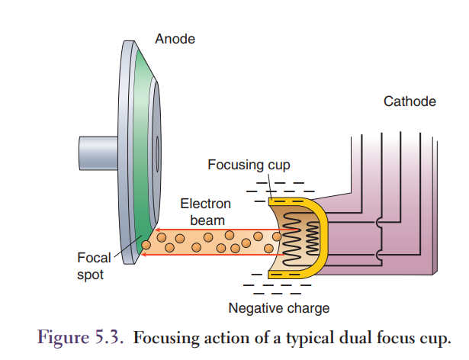

Slide 24
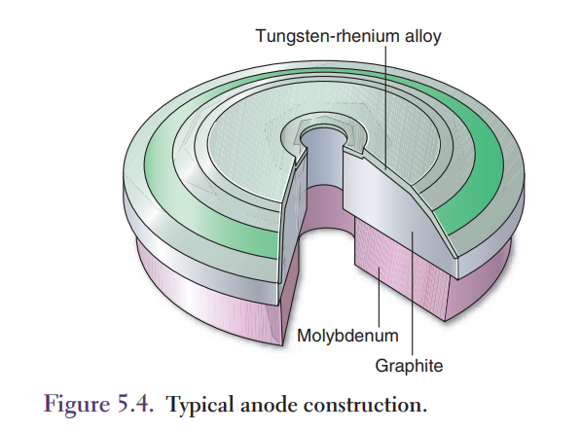

Slide 25
Anode
The positive anode contains the focal spot, which is the area where the projectile electrons stop.
The anode is located on the positive side of the x-ray tube and it has three functions: it serves as a target surface for high-voltage electrons from the fi lament and is the source of x-ray photons; it conducts the high voltage from the cathode back into the x-ray circuitry; and it serves as the primary thermal conductor.
When the projectile electrons hit the anode, more than 99% of the electron energy is deposited in the anode as heat.
Only about 1% of the projectile electron energy is converted to x-ray photons.

Slide 26
Anode Materials
The focal spot on the anode can reach temperatures >3,000°C during an x-ray exposure.
The anode must be made of a material with a high melting point because most metals melt at these temperatures.
Tungstenrhenium alloys, which melt at 3,400°C, are commonly used as the target focal track material in anode construction.

Slide 27
Anode Materials
Tungsten is the metal of choice for three reasons:
1. high atomic number
2. high melting point
3. heat conduction ability

Slide 28
Tungsten’s atomic number of 74 results in production of diagnostic-range photons.
There are tremendous temperatures created with each x-ray exposure, and tungsten’s high melting point allows it to withstand normal use and o perating temperatures.
Tungsten also conducts heat very well, which helps the anode cool down.
Heat from the focal spot is carried to the remainder of the anode by conduction.

Slide 29
Anode heat is transferred from the anode to the walls of the tube housing by radiation.
The housing walls are cooled by convection of room air, which may be increased by fans mounted on the housing (Fig. 5.4).
In addition to tungsten, molybdenum or graphite are layered under the tungsten target.
Both molybdenum and graphite are less dense metals than tungsten, which makes it easier to rotate the anode.
Molybdenum also has a high melting point while graphite-backed anodes can double the heat loading capacities without increasing wear to the bearings.

Slide 30
Rotating Anode
The rotating anode consists of a target, shaft, and rotor.
Rotating anodes spread the heat produced when the electrons bombard a circular track (Fig. 5.5) rather than concentrating the energy in a single spot on the anode surface.
The x-ray source remains fi xed relative to the p atient, but the heat is spread over a circular track as the anode rotates.

Slide 31
Rotating Anode
Most anodes rotate at about 3,600 revolutions per minute (rpm); some high-speed tubes rotate at 10,000 rpm for greater heat dissipation.
Changing the anode rotation speed changes the anode heat capacity but does not change the focal spot size.
The anode, shaft, and rotor are sealed inside an evacuated tube.
Conventional motors using slip rings to provide electrical contact with the rotor are not used to drive the anode because the slip rings would destroy the vacuum inside the tube.

Slide 32
Rotating Anode
Instead, an induction motor is used to rotate the anode.
The rotor is made up of a shaft of copper bars with an iron core in the middle.
Electromagnets called stators are fi xed on the outside of the glass envelope and are activated by an electric current in a synchronized arrangement.
The magnetic fi eld of the electric current sets up around the stator and interacts with the ferromagnetic rotor, causing the rotor to turn in synch with the stator.

Slide 33
Rotating Anode
The shaft, connecting the rotating anode to the rotor, is made of molybdenum and is supported by bearings.
Molybdenum is a strong metal with low heat conductivity.
Its low thermal conductivity prevents the anode heat from reaching and damaging the rotor bearings.
Bearing damage is a major cause of tube failure.

Slide 34
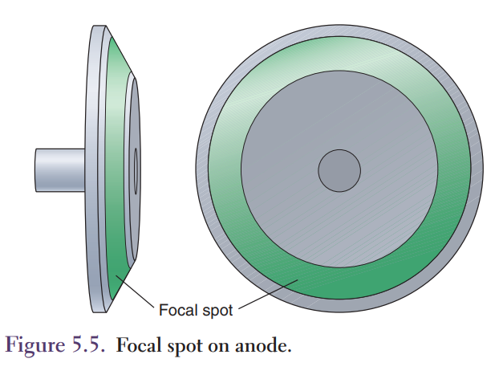

Slide 35
Target Area
The portion of the anode where the high-voltage electron stream will impact is called by the following names:
the target, the focal point, the focal spot, or the focal track.
This is the area where the x-ray photons are created.
Since the target is the point where x-ray photons are created, it is this exact point at which all tube-to-object and image-receptor distances are measured.

Slide 36
Target Area
The tape measure located on he tube never begins at zero because you must take into account the distance from the target to the image receptor.
In the rotating anode the circular path that will be bombarded with the electron beam is called the focal track.
The terms target, focal point, and focal spot all refer to the area on the focal track where the electron beam will strike.

Slide 37
Target Area
Two other terms we must discuss are actual focal spot and effective focal spot.
Actual focal spot is used to describe the actual area on the focal track which is impacted.
The effective focal spot describes the area of the focal spot that is projected out of the tube and toward the object being imaged (Fig. 5.6).

Slide 38
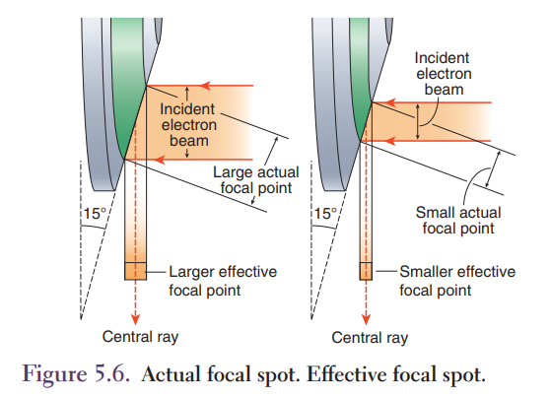

Slide 39
Line Focus Principle
Tilting the anode surface so there is an angle between the surface and the x-ray beam spreads the heat over a larger area while maintaining a smaller focal spot for sharper images.
This is known as the line focus principle.
The sharpness of the final x-ray image is determined by the focal spot size.
Smaller focal spots produce sharper images.

Slide 40
Line Focus Principle
The size of the focal spot, as seen by the patient or image receptor, is known as the effective focal spot size and is smaller than the actual focal spot size because of the line focus principle.
The surface of the anode is angled to spread the heat from the projectile electrons over a larger area.

Slide 41
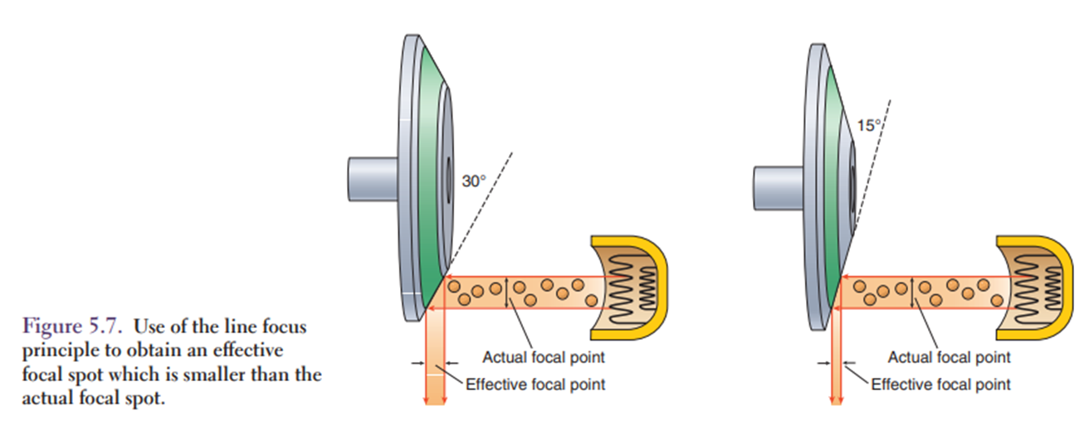
Line Focus Principle
The angle between the anode surface and the x-ray beam shown in Figure 5.7 is called the anode angle.
Figure 5.7 illustrates how reducing the anode angle reduces the effective focal spot size, while maintaining the same area on the anode surface (actual focal spot).

Slide 42
Line Focus Principle
Radiographic tubes have anode angles from 12 to 17 degrees.
The smaller target angle results in a smaller effective focal spot size, better detailed images, and decreased heat capacity in the anode.
Spreading the heat over a larger area allows for increased mA values.
The line focus principle produces sharper images because the effective focal spot is always smaller than the actual focal spot.
The anode angle is set during tube construction by the manufacturer.
Unfortunately, reducing the target area on the anode by applying the line focus principle also increases the heel effect.

Slide 43
Heel Effect
The heel effect produces an intensity variation between the cathode and anode sides of the x-ray field.
This causes a variation in density across the image from the anode side to cathode side, where the radiation intensity is greater on the cathode side.
The heel effect is caused because most x-rays are produced below the anode surface.

Slide 44
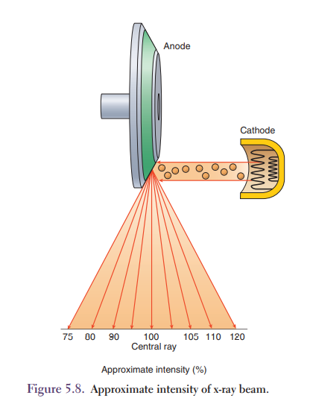
Heel Effect
The x-ray intensity is decreased toward the anode side of the tube
because the x-rays emitted in that direction must pass through more anode material than x-rays emitted toward the cathode side of the field.
figure 5.8 shows how x-rays emitted toward the cathode side of the x-ray tube pass through less anode material than x-rays emitted toward the anode side of the field.

Slide 45
Heel Effect
The heel effect can produce intensity variations of more than 40% between the anode and cathode sides of the field.
The heel effect is more noticeable with smaller anode angles, larger field sizes, and shorter source to image receptor distances (SIDs).
Smaller field sizes and larger SID reduce the heel effect.
The heel effect is applied in clinical situations to achieve a more uniform density when there is a large variation of body thickness across the x-ray field.

Slide 46
Heel Effect
The anode is recognized as the “head” end of the table to more fully utilize the heel effect to the best advantage.
The cathode side of the tube is placed over the thicker or more dense body part.
An example of this would be imaging the thoracic spine in an AP projection.
The cathode side would be placed over the lower thoracic spine with the anode toward the upper thoracic area to produce a more uniform density of the entire thoracic spine (Fig. 5.8).

Slide 48
Off-focus Radiation
Off-focus radiation consists of x-rays produced at locations other than the focal spot.
It occurs when projectile electrons strike other parts of the anode away from the focal spot.
Off-focus radiation causes radiographic images to appear unsharp, decreases overall image quality by reducing image contrast, and exposes the patient’s tissue outside the intended imaging area (Fig. 5.9).
Most off-focus radiation is attenuated by the tube housing and the first-stage collimator located near the window of the tube housing.

Slide 49
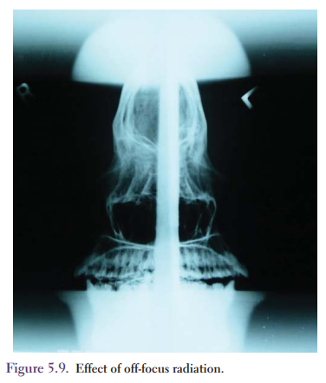

Slide 50
Focal Spot Blooming
Electrostatic repulsion forces the negative electrons to repel each other while traveling from cathode to anode.
Focal spot blooming refers to an increase in the focal spot size with an increase in mA caused by this electrostatic repulsion.
Focal spot blooming is important only with very high mA values and lower kilovoltage (kVp) settings.

Slide 51
Tube Rating Charts and Cooling Curves
Each radiographic unit has a set of charts which help the radiographer use the x-ray tube within a set of acceptable exposures to avoid damage to the x-ray tube.
The three types of tube rating charts are:
1. radiographic tube rating charts
2. anode cooling curves or charts
3. housing cooling charts

Slide 52
Radiographic Tube Rating Charts
Sometimes called tube rating charts, these charts are the most important charts because they guide the radiographer in determining the maximum technical factor combination that can be used without overloading the tube.
Each filament of each tube has a unique tube rating chart to assist in plotting milliamperes, kilovoltage, and time for an exposure.

Slide 53
Radiographic Tube Rating Charts
Each chart plots the kilovoltage on the y-axis and exposure time in seconds on the x-axis.
The various mA stations are plotted within the chart and for any exposure with a combination of kVp and time which falls below or to the left of the mA station is considered safe.
If an exposure is made with a combination of kVp and time which falls above or to the right of the mA station, the exposure is unsafe and may result in sudden tube failure (Fig. 5.10).

Slide 54
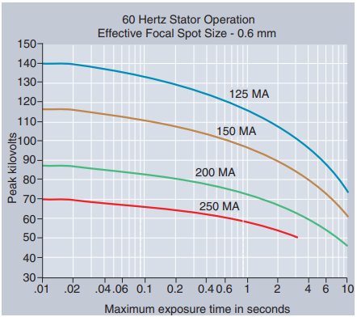
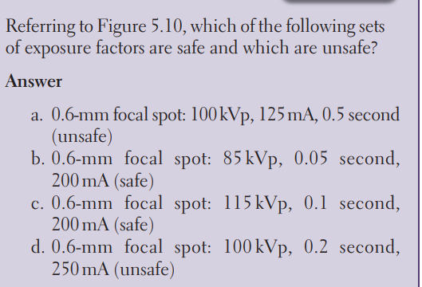

Slide 56
Anode Cooling Curves
Anode cooling curves or charts allow the calculation of the time necessary for the anode to cool enough for additional exposures to be made.
The heat deposited in the anode by the projectile electrons depends on the mA, kVp, and exposure time.
Exposures with higher applied voltages, higher tube currents, and longer exposure times deposit more heat on the anode focal spot.

Slide 57
Anode Cooling Curves
The heat deposited in the anode is measured in heat units (HU).
The number of HU is obtained by using the following formulas:
Single-phase: HU = kVp × mA × time
3-phase, six-pulse: HU = kVp × mA × time × 1.35
3-phase, 12-pulse or high-frequency: HU = kVp × mA × time × 1.41
1.35 and 1.41 are the factors that adjust for the difference in heat deposited in the anode because of the different electrical waveform utilized by x-ray circuitry.

Slide 58

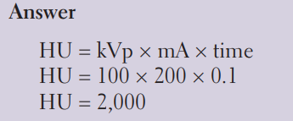

Slide 59

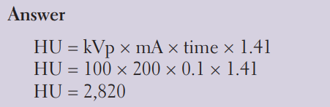

Slide 60

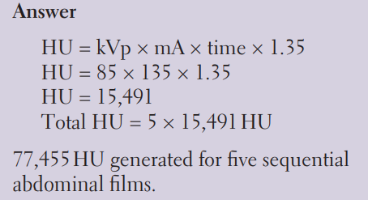

Slide 61
Modern x-ray circuits have safety circuits to prevent the selection of a single unallowed exposure, or multiple unallowed exposures with no cooling between exposures.
It is essential to wait between multiple exposures to allow the anode to cool if each exposure is near the maximum heat capacity of the anode.
Many x-ray circuits will prevent additional exposures from being made until the anode has had sufficient time to cool.

Slide 62
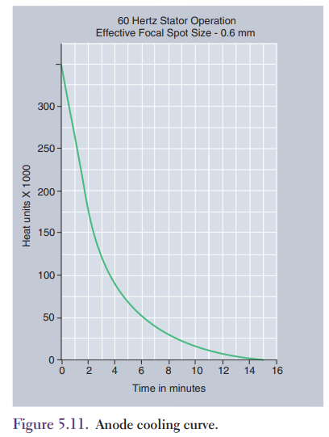
Figure 5.11 represents an anode cooling curve with a maximum heat capacity of 350,000 HU.
The chart is used to determine the amount of time it will take for the anode to completely cool after an exposure.
The initial cooling is quite rapid but as the anode cools the rate of cooling slows down.

Slide 63
For example, a cup of steaming hot chocolate is placed on the counter at room temperature of 70°F.
There is a vast difference between the hot chocolate temperature and room temperature, and the hot chocolate will begin to dissipate its heat rapidly.
As the hot chocolate cools down, there is less heat to dissipate; therefore, the cooling process slows down.
It occurs the same way with the cooling of the anode.

Slide 64
Another use for the anode cooling curve is to determine if a set of exposures will overload the anode.
Using Figure 5.11 again, how long would it take after an initial load of 300,000 HU before a series of exposures equal to 100,000 HU could be made?
The maximum HU is 350,000, and the anode must cool to 250,000 HU in order to take the additional 100,000 HU.
Solve the following

Slide 65
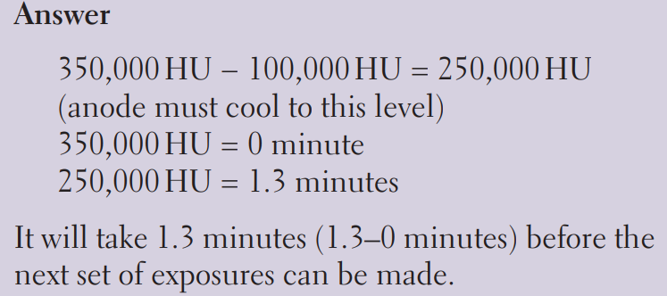
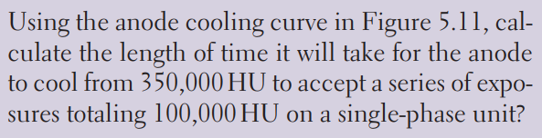

Slide 66
Housing Cooling Charts
The housing cooling charts for the x-ray tube allow the calculations to determine how long it will take to cool the housing so additional exposures can be made.
The charts are very similar to anode cooling charts and are used exactly the same way.
In all actuality, the anode will overheat long before the tube housing as the tube housing has a forced-air fan to dissipate the heat which has built up on the tube housing

Slide 67
Anode Heat Monitors
Modern x-ray circuits are equipped with an anode heat monitor.
This monitor displays the percent of maximum allowed heat that has been deposited in the anode.
The monitor uses the mA, time, and kVp settings to calculate the HU for each exposure.
The anode cooling rate is included in the calculation.

Slide 69
Tube Life and Warm-up Procedures
An x-ray tube costs about the same as a full-size new car.
It is important to extend the life of the tube by properly warming up the tube before beginning clinical exposures.
Tubes fail because of heat damage, either to the bearings or to the anode surface.
Excessive heat can cause filament failure, bearing damage, and anode cracks.
Proper tube warm-up will extend the tube life.

Slide 70
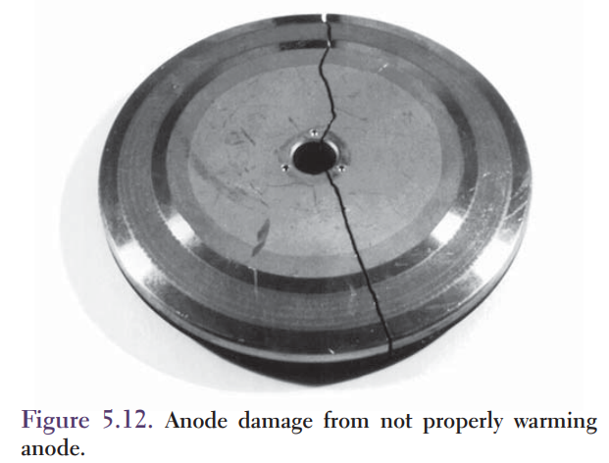
Tube Life and Warm-up Procedures
Figure 5.12 shows an anode after a heat-induced crack split the anode into two pieces.
Proper warm-up exposures eliminate anode cracking by spreading the heat over the entire target surface.
A proper warm-up procedure uses at least a 1-second exposure to include many rotations of the anode during the exposure.

Slide 71
Tube Life and Warm-up Procedures
A very short exposure on a cold anode concentrates the heat on a fraction of the anode surface.
This can cause uneven thermal expansion of the anode and may crack the anode.

Slide 72
Tube Life and Warm-up Procedures
A typical warm-up procedure would consist of two 70 kVp with several low mA long exposures and 2-second exposures.
Tube warm-up procedures should be performed whenever the x-ray tube has not been used for several hours.

Slide 73
While the x-ray unit is on, it remains in the standby mode with a fi lament current of a few amperes keeping the filament warm and ready to be heated to its operating temperature.
Just before the exposure is made, the anode begins rotating and the fi lament is heated to operating temperature by the boost current.
This is termed the prep stage of exposure.
A safety circuit prevents exposure prior to the anode reaching full rotation speed.

Slide 74
The boost current raises the fi lament temperature to begin thermionic emission.
The boost current is present while the exposure switch is activated.
Maintaining the tube in the boost mode or prep stage after the x-ray exposure is completed can significantly shorten tube life by burning out the fi lament.
The exposure switch should be released as soon as the exposure is completed.
The standby mode does not shorten tube life.
Heat is the primary cause of tube failure.
Heat increases rotor bearing wear and damages the anode surface.
When tube bearings begin to fail, they emit a grinding noise noticeable after every exposure.

Slide 76
Chapter Summary
The negative cathode of the x-ray tube contains the filament.
Thermionic emission from the heated filament produces projectile electrons which are accelerated to the positive anode.
The positive anode is a disk-shaped structure constructed of a high atomic number alloy with high thermal conductivity and has a high melting point.
The anode and cathode are contained in an evacuated glass tube surrounded by oil inside a metal housing.

Slide 77
Chapter Summary
The oil provides electrical insulation and cooling.
The projectile electrons stop in the anode and produce x-rays photons.
More than 99% of the electron energy is converted to heat in the anode; the remainder is converted to x-ray photons.
X-ray tubes utilize rotating anodes to distribute the heat around a circular track on the anode surface.
The line focus principle uses an angled anode to spread the heat over a larger area (the actual focal spot) while still maintaining a smaller effective focal spot as seen by the patient.

Slide 78
Chapter Summary
The heel effect causes different x-rays intensities at the cathode and anode ends of the tube that limit the useful fi eld size.
The heel effect is caused because some of the x-rays are produced below the anode surface.
These x-rays are attenuated as they leave the anode.
The intensity at the anode end is less than at the cathode end of the field.
HU are the product of the kVp, the mA, and the exposure time.
HU depend on the focal spot size and the type of x-ray circuit used.
It is important to extend the tube life by following

